Slide 1

Modern Programming Tools And Techniques-I
Lecture 8: Inheritance

Slide 2
Introduction
Object-oriented programming allows classes to inherit commonly used state and behavior from other classes.
In the Java programming language, each class is allowed to have one direct super-class, and each super-class has the potential for an unlimited number of subclasses.
Inheritance is a fundamental object-oriented design technique used to create and organize reusable classes.

Slide 3
Inheritance
Inheritance defines an is-a relationship between a super-class and its subclasses. It means that the subclass (child) is a more specific version of the super-class (parent).
An object of a subclass can be used wherever an object of the super-class can be used.
Inheritance is used to build new classes from existing classes.
The inheritance relationship is transitive: if class y extends class x, and a class z extends class y, then z will also inherit from class x.

Slide 4
Inheritance
Using inheritance, we can create a general class that defines traits(state and behaviors) common to a set of related items.
This class can then be inherited by other, more specific classes, each adding those things that are unique to it.
In Java, a class that is inherited is called a super-class.
The class that does the inheriting is called a subclass.
Therefore, a subclass is a specialized version of a super-class. It inherits all of the instance variables and methods defined by the super-class and adds its own, unique elements.

Slide 5
Types of Inheritance
The following kinds of inheritance are there in java.
  Simple Inheritance
  Multilevel Inheritance
Simple Inheritance: A subclass is derived simply from it's parent class.
There is only a sub class and it's parent class. It is also called single inheritance or one level inheritance.
Multi-level Inheritance: A subclass is derived from a derived class.

Slide 6
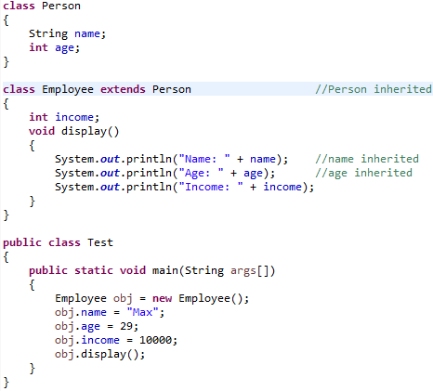
Example (Simple inheritance)

Slide 7
Multiple Inheritance
The mechanism of inheriting the features of more than one base class into a single class is known as multiple inheritance.
Java does not support multiple inheritance using classes but the multiple inheritance can be achieved by using the interface.
In Java Multiple Inheritance can be achieved through use of Interfaces by implementing more than one interfaces in a class.

Slide 8
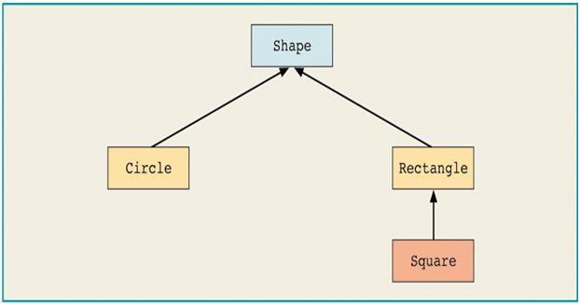

Slide 9
Inheritance Example
class Shape {
int area(){…}
}
class Rectangle extends Shape{
int area() { area = length * width;}
int length; int width;
}
class Square extends Rectangle {
int area() {…}
int length; int width = length;
}

Slide 10
Accessing parent class members

Slide 11
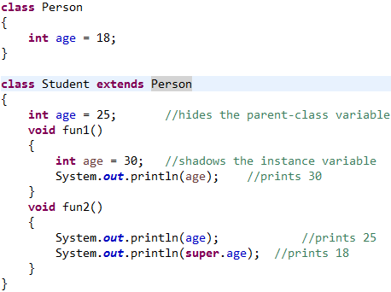
Example (access parent member)

Slide 12
Functionality of constructors in Inheritance

Slide 13
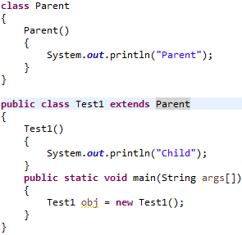
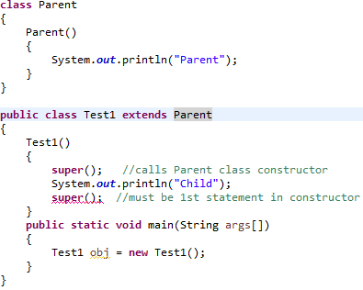
Example (constructor calling in inheritance)

Slide 14
Key Points
Private members of the super-class are not inherited by the subclass.
Members that have default accessibility in the super-class are also not inherited by subclasses in other packages.
Constructors and initializer blocks are not inherited by a subclass.
A subclass can extend only one super-class.

Slide 15
Method overriding

Slide 16
Method Overriding
Method overriding means having a different implementation of the same method in the inherited class.
These two methods would have the same signature, but different implementation.
One of these would exist in the base class and another in the derived class. These cannot exist in the same class.
Note:- A class declared as final cannot be inherited and a method declared final cannot be overridden in sub-class.

Slide 17
Key Points
The version of a method that is executed will be determined by the object that is used to invoke it.
If an object of a parent class is used to invoke the method, then the version in the parent class will be executed.
If an object of the subclass is used to invoke the method, then the version in the child class will be executed.

Slide 18
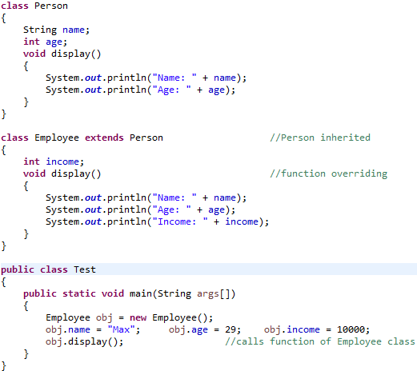
Example (method overriding)

Slide 19
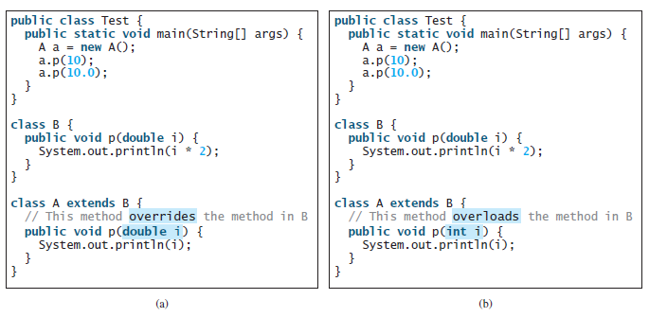
Difference b/w Overloading & Overriding

Slide 20
Dynamic Method Dispatch
Dynamic method dispatch is the mechanism by which a call to an overridden method is resolved at run time, rather than compile time.
Dynamic method dispatch is important because this is how Java implements run-time polymorphism.

Slide 21
Example
class A
{
void callme() {
System.out.println("Inside A's callme method");
}
}
class B extends A
{
void callme() {
System.out.println("Inside B's callme method");
}
}
class C extends A
{
void callme() {
System.out.println("Inside C's callme method");
}
}

Slide 22
class Dispatch
{
public static void main(String args[])
{
A a = new A(); // object of type A
B b = new B(); // object of type B
C c = new C(); // object of type C
A r; // obtain a reference of type A
r = a; // r refers to an A object
r.callme(); // calls A's version of callme()
r = b; // r refers to a B object
r.callme(); // calls B's version of callme()
r = c; // r refers to a C object
r.callme(); // calls C's version of callme()
}
}

Slide 23
Role of instanceof operator

Slide 24
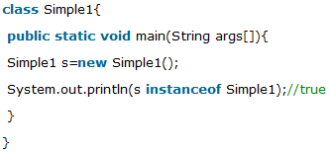
instanceof operator
The java instanceof operator is used to test whether the object is an instance of the specified type (class or subclass or interface).
The instanceof in java is also known as type comparison operator because it compares the instance with type. It returns either true or false. If we apply the instanceof operator with any variable that has null value, it returns false.

Slide 25
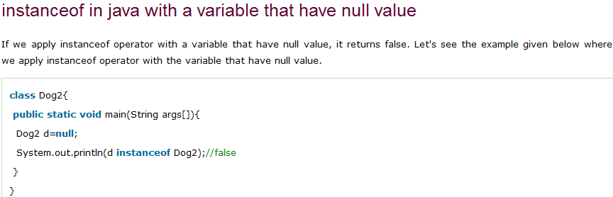

Slide 26
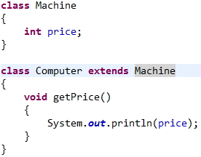
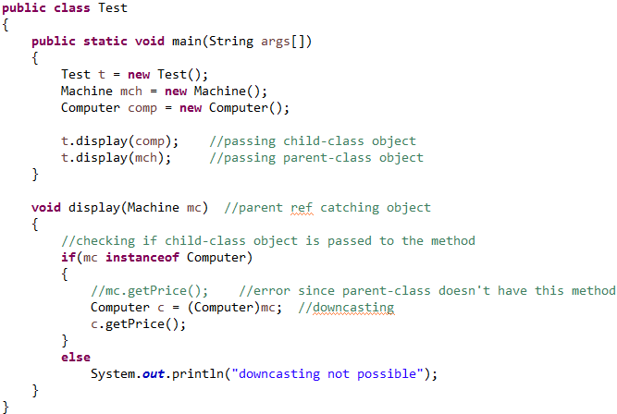
Possibility of downcasting with instanceof

Slide 27


